Slide 1

307307 Introduction Word Embeddings

Slide 2
Introduction to Word Embeddings

Slide 3
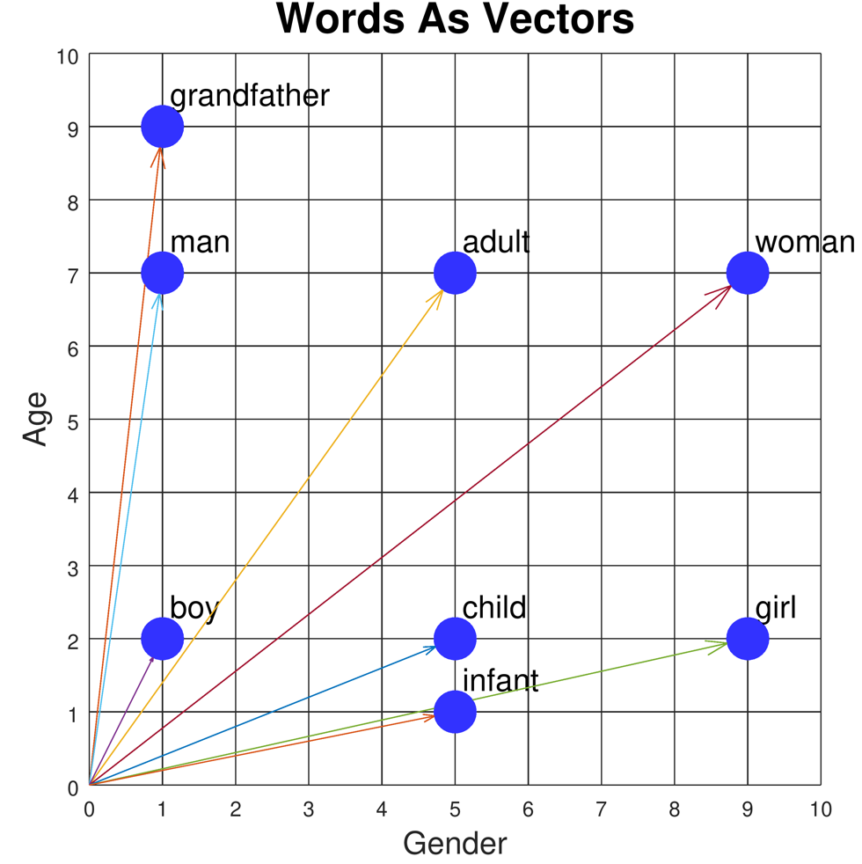
Introduction to Word Embeddings
Definition: Word embeddings are vector representations of words in a continuous vector space
Purpose: Capture semantic and syntactic relationships between words
Key innovation: Words with similar meanings have similar vector representations
Foundation of modern NLP: Enable machines to understand relationships between words

Slide 4
The Evolution of Word Representations
Traditional Methods (Pre-2013)
One-hot encoding: Sparse, binary vectors (dimension = vocabulary size)
Limitations:
No notion of similarity between words
Curse of dimensionality
No semantic information captured
Word | Dimension 1 (cat) | Dimension 2 (dog) | Dimension 3 (fish) | Dimension 4 (bird)
cat | 1 | 0 | 0 | 0
dog | 0 | 1 | 0 | 0
fish | 0 | 0 | 1 | 0
bird | 0 | 0 | 0 | 1

Slide 5
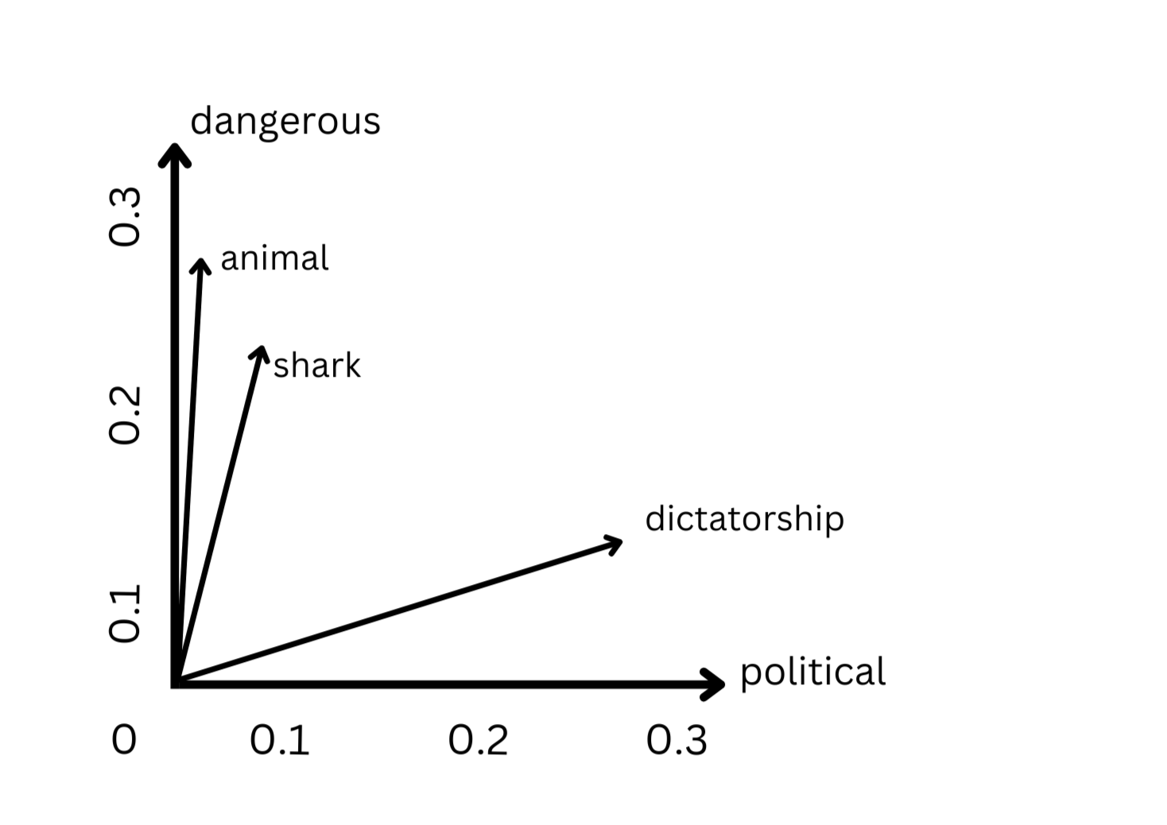
The Evolution of Word Representations
Problem: How do we represent meaning mathematically?
Solution: Distributional hypothesis - "You shall know a word by the company it keeps" (J.R. Firth, 1957)
Word | Dimension 1 (political) | Dimension 2 (dangerous)
shark | 0.05 | 0.22
animal | 0.03 | 0.25
dangerous | 0.07 | 0.32
political | 0.31 | 0.04
dictatorship | 0.28 | 0.15
Words are represented as dense vectors in a continuous vector space
Each dimension potentially captures semantic meaning
Similar words cluster together in the vector space
Semantic relationships are preserved (e.g., "shark" is closer to "dangerous" than "political")
Enables meaningful similarity measurements and analogies

Slide 6
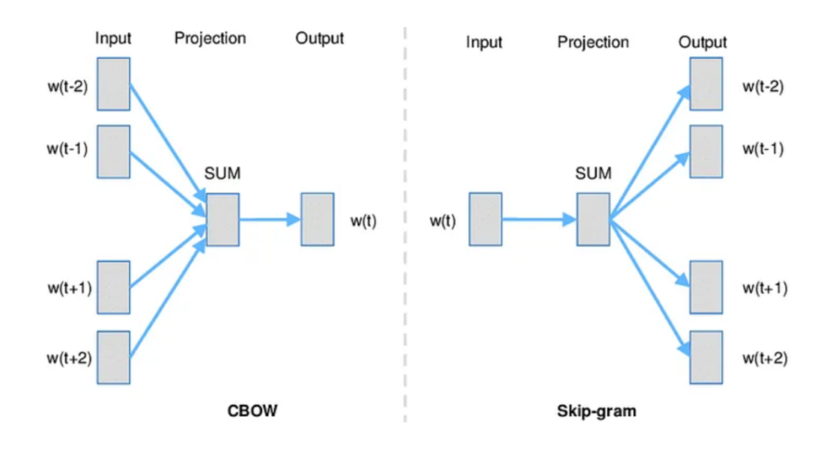
Word2Vec (Mikolov et al., 2013)
Key Innovation
Transformed NLP by creating dense vector representations through prediction-based models
Two Architectures
Continuous Bag of Words (CBOW):
Predicts target word from context words
Faster training, better for frequent words
Skip-gram:
Predicts context words from target word
Better for rare words, captures more semantic information
Characteristics
Typically 100-300 dimensions (vs. vocabulary size)
Linear relationships: king - man + woman ≈ queen
Efficient training through negative sampling
Limitations: Fixed vectors, one vector per word regardless of context

Slide 7
import gensim
from gensim.models import Word2Vec
import nltk
from nltk.tokenize import word_tokenize
nltk.download('punkt')
# Sample corpus
sentences = [
"Large language models are transforming business applications",
"Natural language processing helps computers understand human language",
"Word embeddings capture semantic relationships between words",
"Neural networks learn distributed representations of words",
"Businesses use language models for various applications",
"Customer service can be improved with language technology",
"Modern language models require significant computing resources",
"Language models can generate human-like text for businesses"]
# Tokenize the sentences
tokenized_sentences = [word_tokenize(sentence.lower()) for sentence in sentences]
# Train Word2Vec model
model = Word2Vec(sentences=tokenized_sentences,
vector_size=100, # Embedding dimension
window=5, # Context window size
min_count=1, # Minimum word frequency
workers=4) # Number of threads
# Save the model
model.save("word2vec.model")
# Find the most similar words to "language"
similar_words = model.wv.most_similar("language", topn=5)
print("Words most similar to 'language':")
for word, similarity in similar_words:
print(f"{word}: {similarity:.4f}")
# Vector for a specific word
word_vector = model.wv["business"]
print(f"\nVector for 'business' (first 10 dimensions):\n{word_vector[:10]}")
# Word analogies
analogy_result = model.wv.most_similar(positive=["business", "language"],
negative=["models"],
topn=3)
print("\nAnalogy results:")
for word, similarity in analogy_result:
print(f"{word}: {similarity:.4f}")

Slide 8
Practical Implementation: Word2Vec in Python
import gensim.downloader as api
from gensim.models import Word2Vec
import numpy as np
# Load pre-trained Word2Vec model
word2vec_model = api.load('word2vec-google-news-300’)
# Find similar words
similar_words = word2vec_model.most_similar('computer', topn=5)
print("Words similar to 'computer':", similar_words)
# Word analogies
result = word2vec_model.most_similar(positive=['woman', 'king'], negative=['man'], topn=1)
print("king - man + woman =", result)
# Train your own Word2Vec model
sentences = [["cat", "say", "meow"], ["dog", "say", "woof"]]
model = Word2Vec(sentences, vector_size=100, window=5, min_count=1, workers=4)
# Get vector for a word
cat_vector = model.wv['cat']
print("Vector for 'cat':", cat_vector[:5]) # Show first 5 dimensions

Slide 9
Practical Implementation: GloVe in Python
import numpy as np
from sklearn.metrics.pairwise import cosine_similarity
# Function to load GloVe vectors
def load_glove_vectors(file_path):
embeddings_dict = {}
with open(file_path, 'r', encoding='utf-8') as f:
for line in f:
values = line.split()
word = values[0]
vector = np.array(values[1:], dtype='float32')
embeddings_dict[word] = vector
return embeddings_dict
# Load pre-trained GloVe vectors
glove_vectors = load_glove_vectors('glove.6B.100d.txt')
# Calculate word similarity
def get_similarity(word1, word2, embeddings):
if word1 in embeddings and word2 in embeddings:
vec1 = embeddings[word1].reshape(1, -1)
vec2 = embeddings[word2].reshape(1, -1)
return cosine_similarity(vec1, vec2)[0][0]
return None
# Example usage
similarity = get_similarity('king', 'queen', glove_vectors)
print(f"Similarity between 'king' and 'queen': {similarity:.4f}")

Slide 10
Practical Implementation: BERT in Python
import torch
from transformers import BertModel, BertTokenizer
# Load pre-trained BERT model and tokenizer
tokenizer = BertTokenizer.from_pretrained('bert-base-uncased')
model = BertModel.from_pretrained('bert-base-uncased')
# Input text
text = "The quick brown fox jumps over the lazy dog."
# Tokenize input
inputs = tokenizer(text, return_tensors="pt")
# Get BERT embeddings
with torch.no_grad():
outputs = model(**inputs)
# Last hidden states contain contextual embeddings for each token
last_hidden_states = outputs.last_hidden_state
# Get embedding for the first token (after [CLS])
word_embedding = last_hidden_states[0, 1].numpy()
print(f"BERT embedding for 'The' (first 5 dimensions): {word_embedding[:5]}")
# Get embeddings for full sentence (CLS token)
sentence_embedding = last_hidden_states[0, 0].numpy()

Slide 14
How to Represent a Word?
Problem: distance between words using one-hot encodings always the same
dog
cat
person
1
2
3
$$[1 0 0 0 0 0 0 0 0 0 ]$$
$$[0 1 0 0 0 0 0 0 0 0 ]$$
$$[0 0 1 0 0 0 0 0 0 0 ]$$
Idea: Instead of one-hot-encoding use a histogram of commonly co-occurring words.

Slide 15
Distributed Symantec
Word2Vec

Slide 16
How to Represent a Word?

Slide 17
How to represent a word?
Problem: distance between words using one-hot encodings always the same
dog
cat
person
1
2
3
$$[1 0 0 0 0 0 0 0 0 0 ]$$
$$[0 1 0 0 0 0 0 0 0 0 ]$$
$$[0 0 1 0 0 0 0 0 0 0 ]$$
Idea: Instead of one-hot-encoding use a histogram of commonly co-occurring words.
What we see

Slide 18
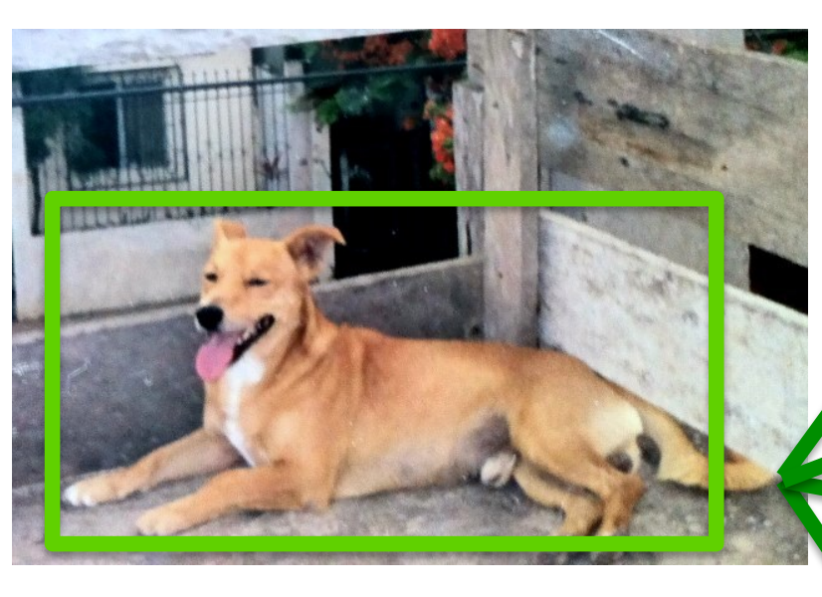
Distributional Semantics
Dogs are man’s best friend.
I saw a dog on a leash walking in the park.
friend
leash
park
walking
walks
food
legs
runs
sleeps
sits
…
His dog is his best companion.
He walks his dog in the late afternoon
…
dog
$$[3 2 3 4 2 4 3 5 6 7 …]$$
What we see

Slide 19
Distributional Semantics
food
walks
window
runs
mouse
invented
legs
sleeps
mirror
tail
…
dog
cat
person
$$[5 5 0 5 0 0 5 5 0 2 …]$$
$$[5 4 1 4 2 0 3 4 0 3 … ]$$
$$[5 5 1 5 0 2 5 5 0 0 …]$$
This vocabulary can be extremely large
What we see

Slide 20
Toward more Compact Representations
food
walks
window
runs
mouse
invented
legs
sleeps
mirror
tail
…
dog
cat
person
$$[5 5 0 5 0 0 5 5 0 2 …]$$
$$[5 4 1 4 2 0 3 4 0 3 … ]$$
$$[5 5 1 5 0 2 5 5 0 0 …]$$
This vocabulary can be extremely large
What we see

Slide 21
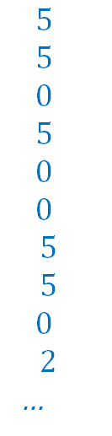
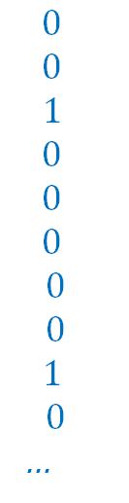
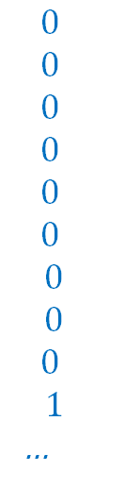
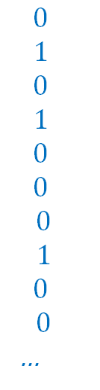
Toward more Compact Representations
$$5$$
$$5$$
$$0$$
$$5$$
$$0$$
$$0$$
$$5$$
$$5$$
$$0$$
$$2$$
…
$$0$$
$$1$$
$$0$$
$$1$$
$$0$$
$$0$$
$$0$$
$$1$$
$$0$$
$$0$$
…
$$0$$
$$0$$
$$0$$
$$0$$
$$0$$
$$0$$
$$0$$
$$0$$
$$0$$
$$1$$
…
$$0$$
$$0$$
$$1$$
$$0$$
$$0$$
$$0$$
$$0$$
$$0$$
$$1$$
$$0$$
…
dog =
=
w1
+ w2
+ w3
+ …
What we see
legs, running, walking
tail, fur,
ears
mirror, window, door

Slide 22
Toward more Compact Representations
dog =
w1
w2
w3
The basis vectors can be found using Principal Component Analysis (PCA)
What we see

Slide 23
What is word2vec?
word2vec is not a single algorithm
It is a software package for representing words as vectors, containing:
Two distinct models
CBoW
Skip-Gram (SG)
Various training methods
Negative Sampling (NS)
Hierarchical Softmax
A rich preprocessing pipeline
Dynamic Context Windows
Subsampling
Deleting Rare Words
Slide by Omer Levy
Notes:
Now, we’re going to focus on Skip-Grams with Negative Sampling,
Which is considered the state-of-the-art.

Slide 24
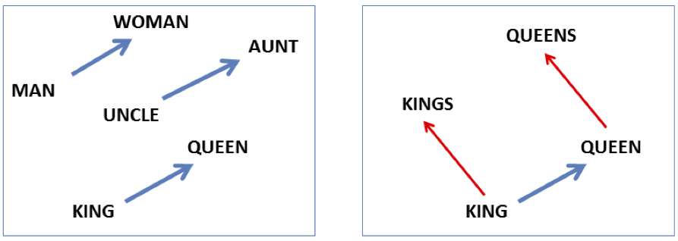

Embeddings capture relational meaning!
vector(‘king’) - vector(‘man’) + vector(‘woman’) $≈$vector(‘queen’)
vector(‘Paris’) - vector(‘France’) + vector(‘Italy’) $≈$ vector(‘Rome’)
Slide by Dan Jurafsky

Slide 25
Skip-Grams with Negative Sampling (SGNS)
Marco saw a furry little wampimuk hiding in the tree.
“word2vec Explained…”
Goldberg & Levy, arXiv 2014
Notes:
So, how does SGNS work?
Let’s say we have this sentence,
(This example was shamelessly taken from Marco Baroni)

Slide 26
Skip-Grams with Negative Sampling (SGNS)
Marco saw a furry little wampimuk hiding in the tree.
“word2vec Explained…”
Goldberg & Levy, arXiv 2014
Notes:
And we want to understand what a wampimuk is.

Slide 27
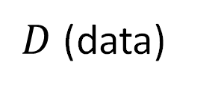
Skip-Grams with Negative Sampling (SGNS)
Marco saw a furry little wampimuk hiding in the tree.
words contexts
wampimuk furry
wampimuk little
wampimuk hiding
wampimuk in
… …
$D$ (data)
“word2vec Explained…”
Goldberg & Levy, arXiv 2014
Notes:
What SGNS does is take the context words around “wampimuk”,
And in this way,
Constructs a dataset of word-context pairs, D.

Slide 28

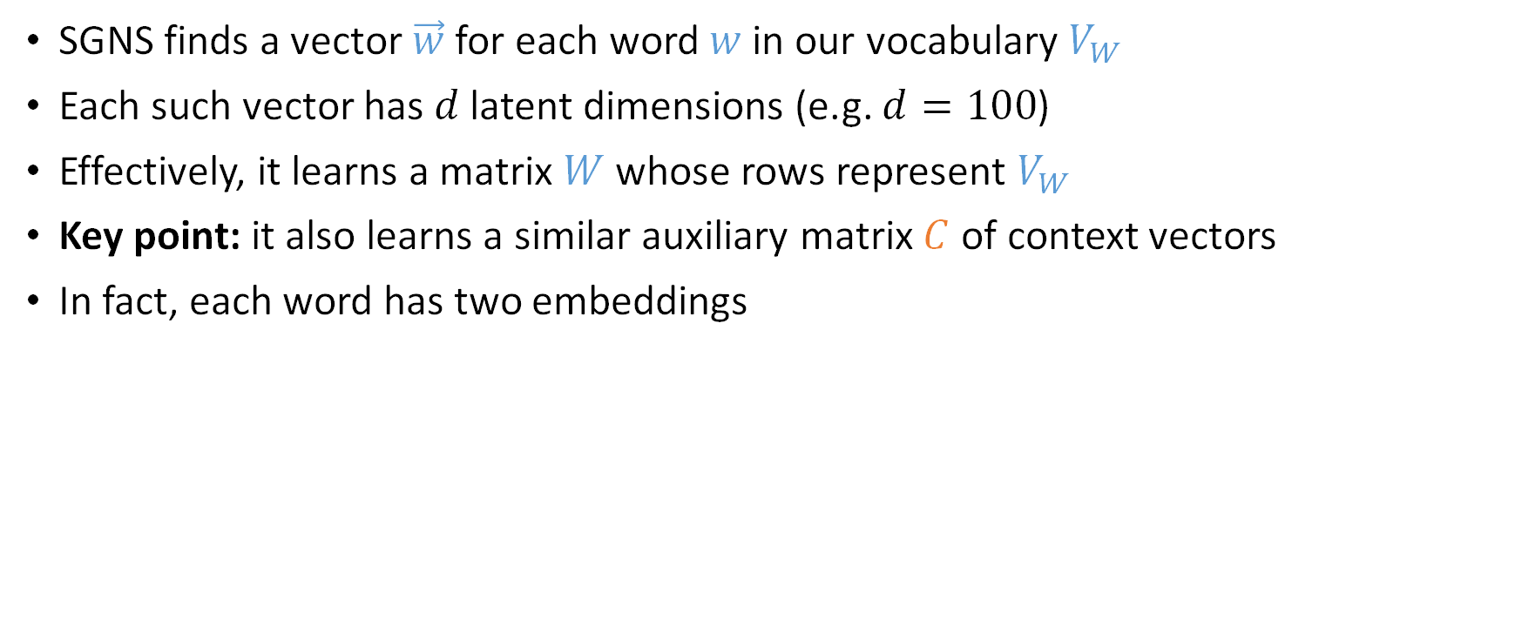
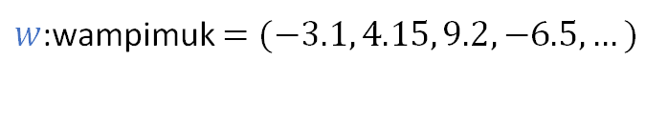



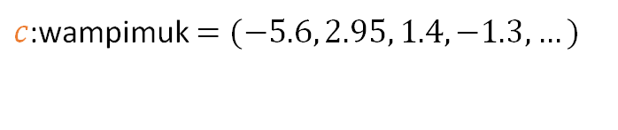


Skip-Grams with Negative Sampling (SGNS)
SGNS finds a vector $\vec{w}$ for each word $w$ in our vocabulary $V_{W}$
Each such vector has $d$ latent dimensions (e.g. $d=100$)
Effectively, it learns a matrix $W$ whose rows represent $V_{W}$
Key point: it also learns a similar auxiliary matrix $C$ of context vectors
In fact, each word has two embeddings
$$d$$
$$d$$
$$W$$
$w$:wampimuk $=(−3.1, 4.15, 9.2, −6.5,…)$
$$C$$
$$V_{W}$$
$$≠$$
$$V_{C}$$
$c$:wampimuk $=(−5.6, 2.95, 1.4, −1.3,…)$
“word2vec Explained…”
Goldberg & Levy, arXiv 2014
Notes:
Now, using D,
SGNS is going to learn a vector for each word in the vocabulary
A vector of say… 100 latent dimensions.
Effectively, it’s learning a matrix W,
Where each row is a vector that represents a specific word.
Now, a key point in understanding SGNS,
Is that it also learns an auxiliary matrix C of context vectors
So in fact, each word has two different embeddings
Which are not necessarily similar.

Slide 29
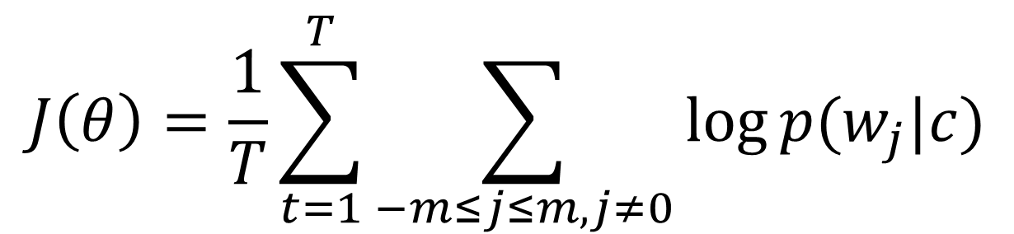
Word2Vec Objective
$$J\left(θ\right)=\frac{1}{T}\sum_{t=1}^{T}{\sum_{−m≤j≤m, j≠0}{\log{p(w_{j}|c)}}}$$

Slide 30
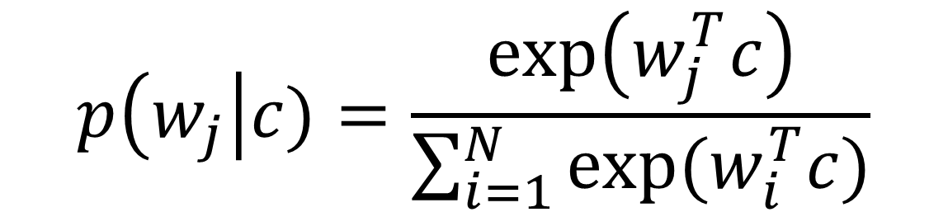
Word2Vec Objective
$$p\left(w_{j}\right|c)=\frac{\exp\left(w_{j}^{T}c\right)}{\sum_{i=1}^{N}{exp⁡(w_{i}^{T}c)}}$$

Slide 31
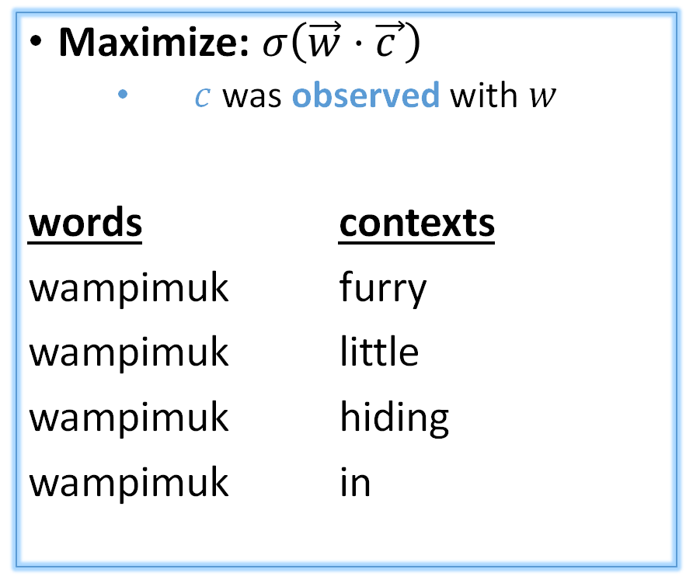
Skip-Grams with Negative Sampling (SGNS)
Maximize: $σ\left(\vec{w}⋅\vec{c_{ }}\right)$
$c$ was observed with $w$
words contexts
wampimuk furry
wampimuk little
wampimuk hiding
wampimuk in
“word2vec Explained…”
Goldberg & Levy, arXiv 2014
Notes:
…SGNS maximizes the similarity between word and context vectors that were observed together.

Slide 32
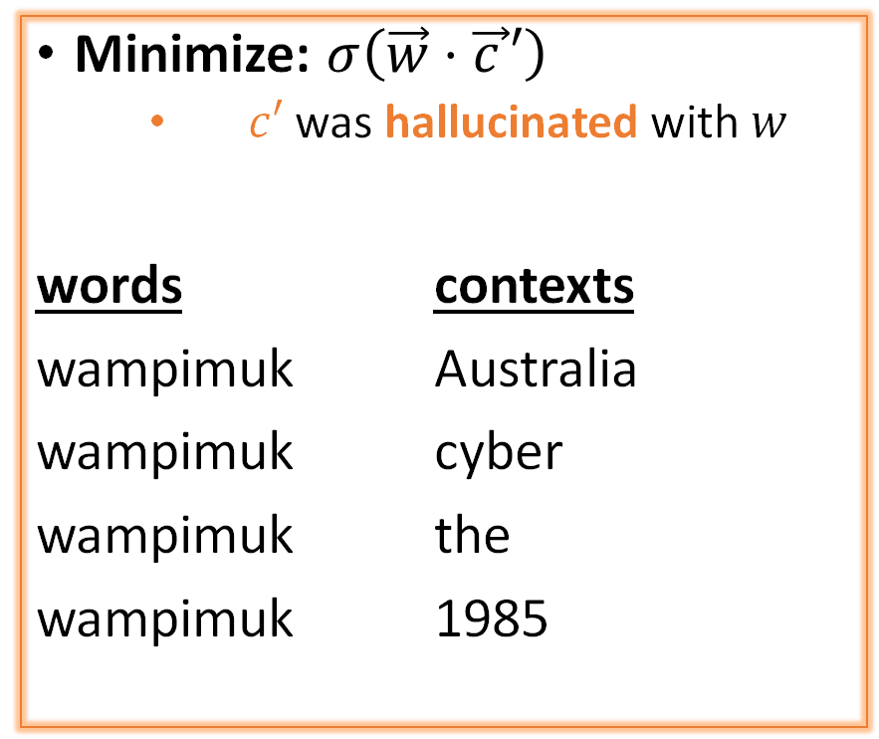
Skip-Grams with Negative Sampling (SGNS)
Maximize: $σ\left(\vec{w}⋅\vec{c_{ }}\right)$
$c$ was observed with $w$
words contexts
wampimuk furry
wampimuk little
wampimuk hiding
wampimuk in
Minimize: $σ\left(\vec{w}⋅\vec{c_{ }}′\right)$
$c′$ was hallucinated with $w$
words contexts
wampimuk Australia
wampimuk cyber
wampimuk the
wampimuk 1985
“word2vec Explained…”
Goldberg & Levy, arXiv 2014
Notes:
…and minimizes the similarity between word and context vectors hallucinated together.

Slide 33
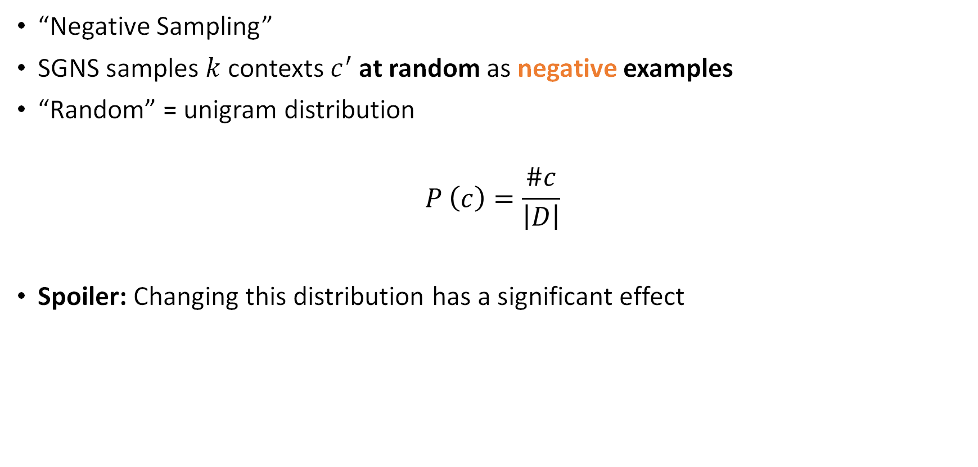
Skip-Grams with Negative Sampling (SGNS)
“Negative Sampling”
SGNS samples $k$ contexts $c^{′}$ at random as negative examples
“Random” = unigram distribution
$$P_{ }^{ }\left(c\right)=\frac{\#c}{\left|D\right|}$$
Spoiler: Changing this distribution has a significant effect
Notes:
Now, the way SGNS hallucinates is really important.
It’s actually where it gets its name from.
For each observed word-context pair,
SGNS samples k contexts at random,
As negative examples
Now, when we say random, we mean the unigram distribution
And Spoiler Alert: changing this distribution has quite a significant effect.

Slide 34
Questions?

